Slide 1
SECURE DATA HIDING IN IMAGES USING STEGANOGRAPHY
CAPSTONE PROJECT
Presented By: ARYAN DIPESH SHAH
Student Name : ARYAN DIPESH SHAH
College Name & Department : Universal College of Engineering
& Computer Engineering

Slide 2
OUTLINE
Problem Statement
Technology used
Wow factor
End users
Result
Conclusion
Git-hub Link
Future scope

Slide 3
Problem Statement
With increasing cyber threats, secure data transmission is crucial. Traditional encryption leaves visible traces, making detection easier. Steganography allows embedding messages inside images, ensuring confidentiality. This project hides secret messages within images, ensuring they remain undetectable.

Slide 4
Technology used
• Programming Language: Python
• Libraries: OpenCV, OS
• Platform: Windows
• Image Processing: RGB Pixel Manipulation
• Encryption Method: Character-based Steganography

Slide 5
Wow factors
• Real-time encryption and decryption of messages in images
• Fully automated process with a simple user interface
• Password-protected decryption for enhanced security
• Supports different image formats (JPG, PNG, etc.)
• No visible changes in image after encryption

Slide 6
End users
• Government Agencies (Secure communication)
• Cybersecurity Professionals (Data hiding research)
• Journalists & Activists (Safe message transmission)
• Intelligence & Military Operations
• General Users seeking private communication

Slide 7
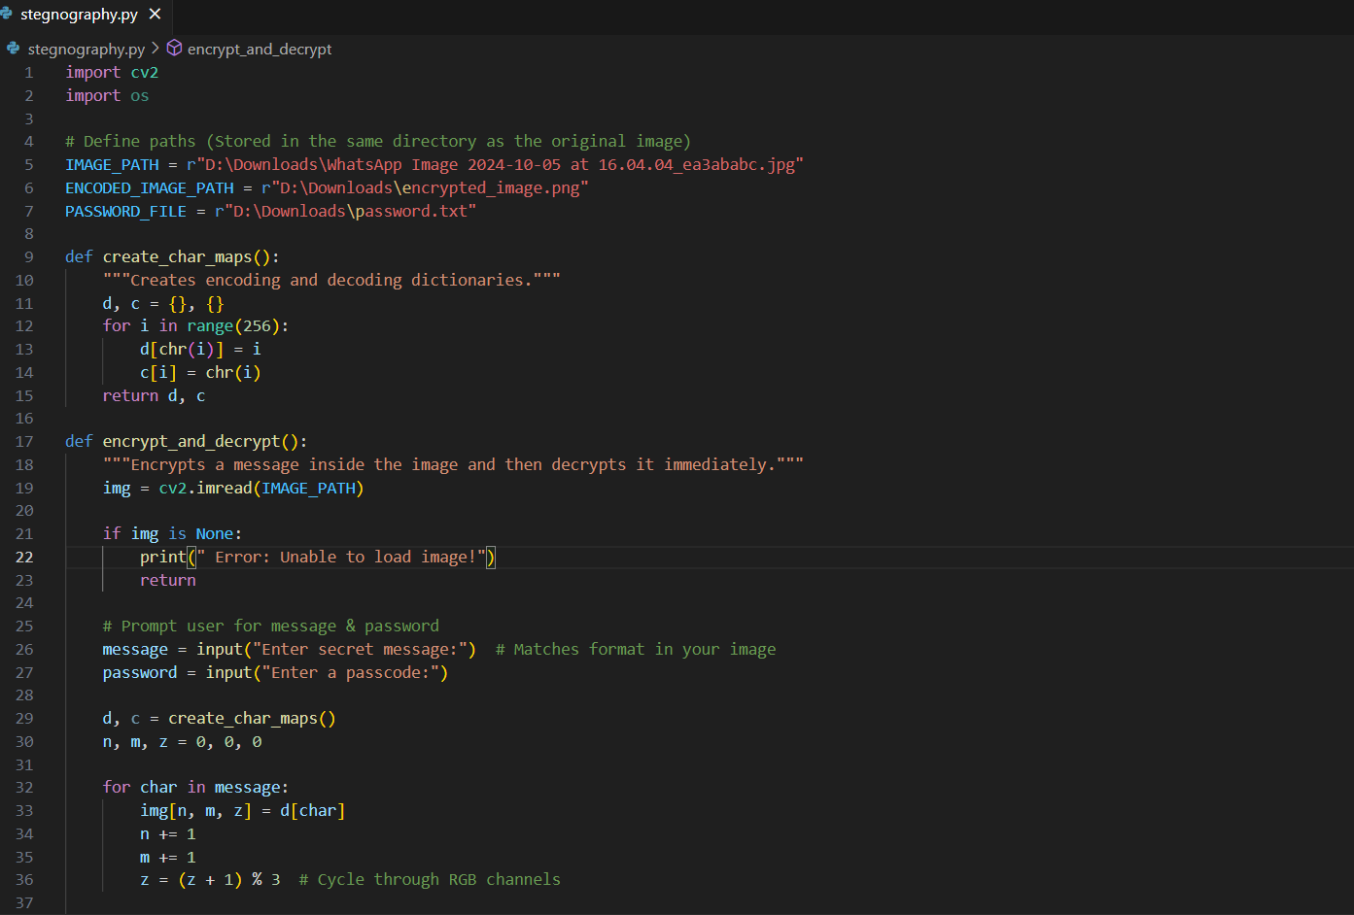
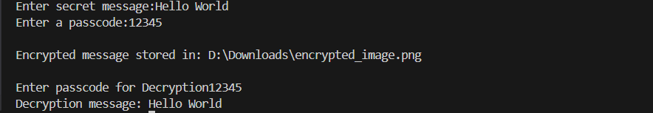
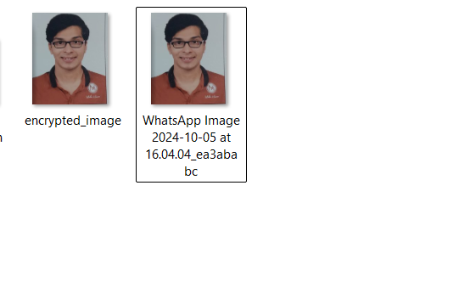
Results

Slide 8
Conclusion
This project successfully implements image-based steganography for secure communication. It enables users to embed and retrieve messages without altering the image visibly. By combining encryption with steganography, it enhances cybersecurity and privacy. The system ensures secure message transmission, making it useful for multiple real-world applications.

Slide 9
GitHub Link
https://github.com/Aryanshah13/AICTE-Project

Slide 10
Future scope(optional)
• Extend to audio and video steganography
• Use AI for enhanced security and undetectability
• Implement advanced cryptographic techniques
• Develop a GUI-based application for wider usability
• Optimize for faster encryption and decryption

Slide 11
THANK YOU

